Slide 1

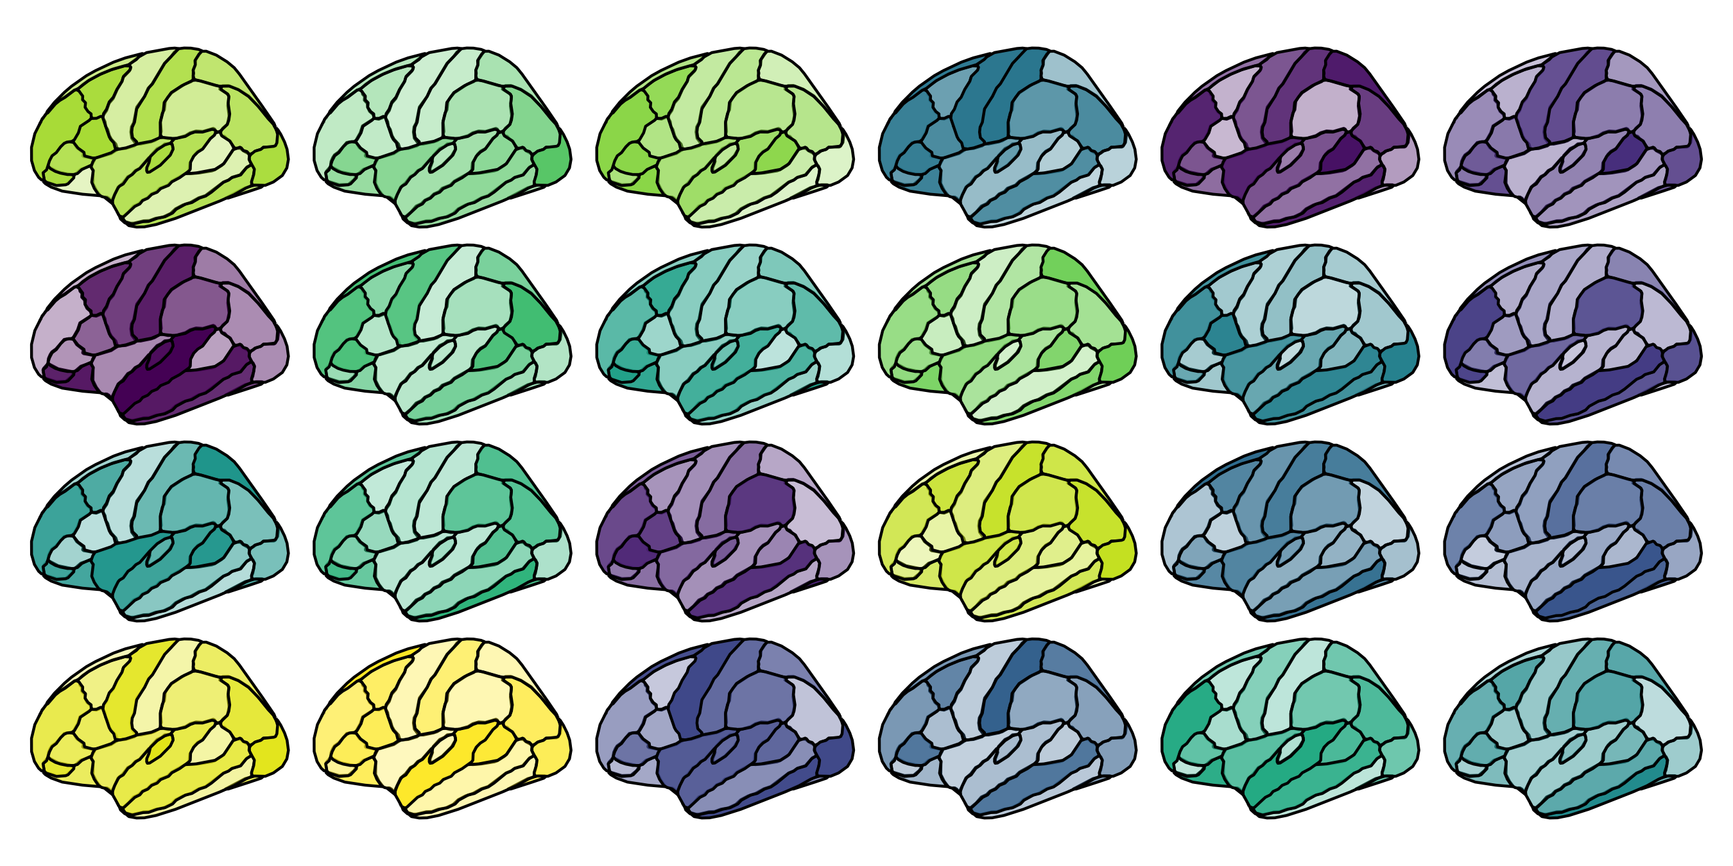

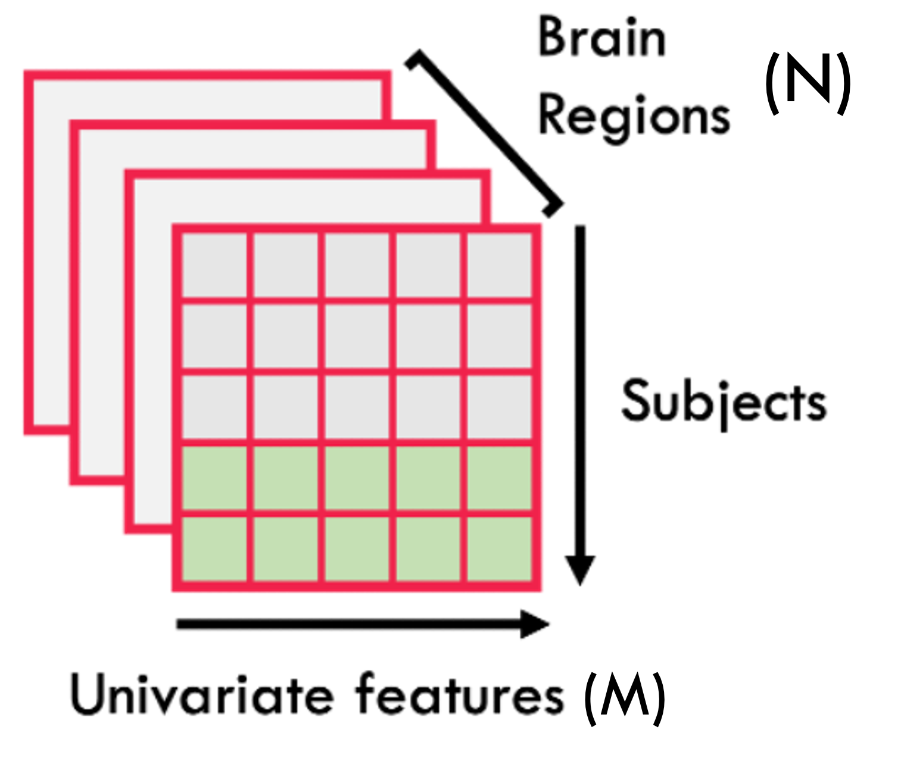
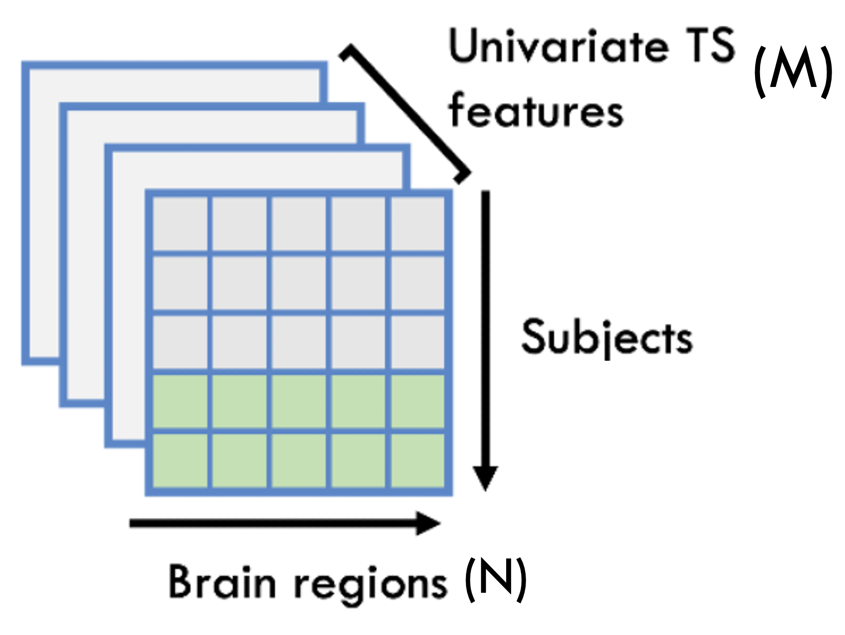
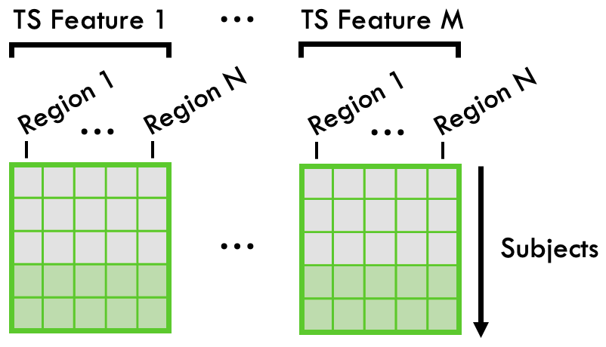

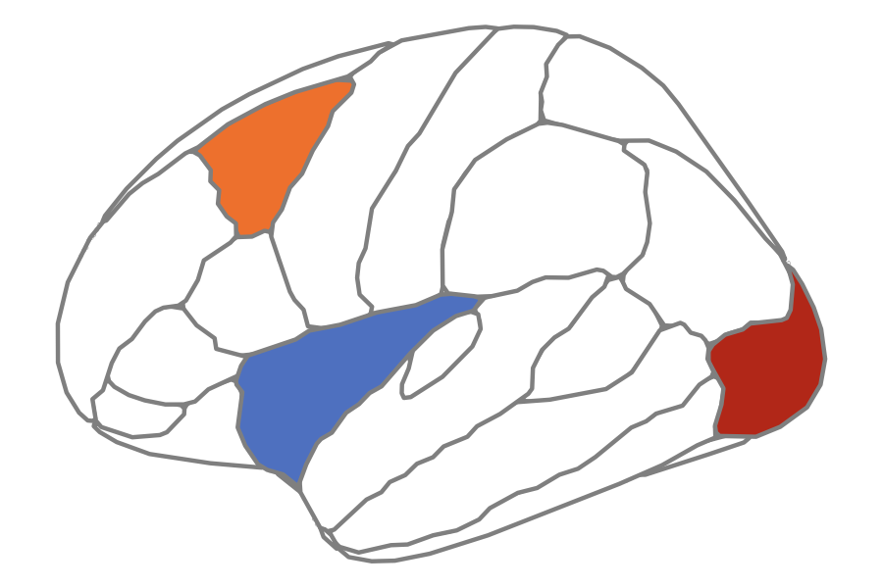

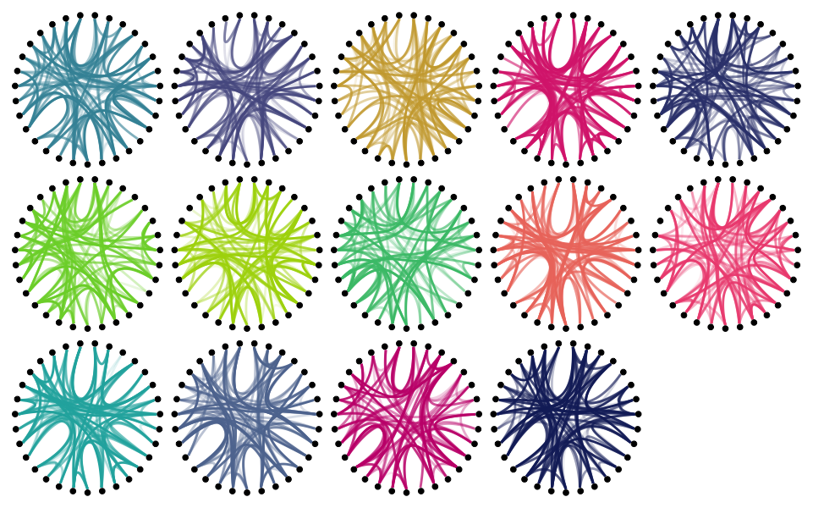
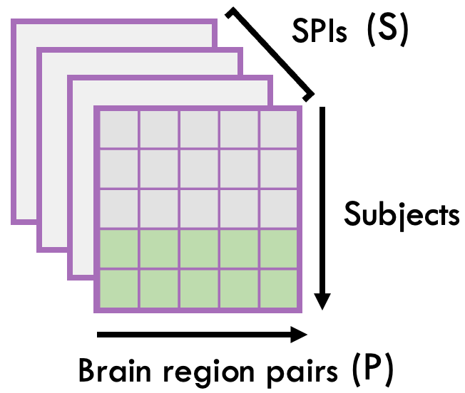




A
UCLA CNP Cohort
ABIDE Cohort
Control (N=116)
SCZ (N=48)
BPD (N=49)
ADHD (N=39)
Control (N=578)
ASD (N=513)
B
C
D
Participants
Features
Compute 24 univariate BOLD rs-fMRI features
By brain region
By feature
With all brain regions × features
Features
Repeat to extract M univariate features from all N brain regions per participant
E
F
G
H
Participants
+
Compute 14 pairwise BOLD rs-fMRI SPIs
By SPI
By SPI with all regions × univariate features
SPIs
SPIs
Repeat to extract S SPIs from all P brain region pairs per participant
With all brain pairs × SPIs

